Slide 1
Parent/Carer Update 23rd August 2024
CONTACT US:
Phone: 01586553773
Email: enquiriescampbeltown@argyll-bute.gov.uk
Website: www.campbeltowngrammar.com
Facebook: wwww.facebook.com/campbeltowngrammarschool Twitter: https://twitter.com/CampbeltownGS

Slide 2
Welcome Prizegiving
Welcome back! We are delighted to welcome everyone back to Campbeltown Grammar School and excited to have our new S1 with us who have settled in very well.
We have listened to parental feedback and would like to improve communication between parents and CGS so have developed this fortnightly newsletter to keep you updated. We will play around with different formats and ask for feedback. We will continue to update our social media feeds also. Paper copies of this are available from the School Office.
We will also be reminding our pupils about the mobile phone policy and continue to appreciate your support as we manage the use of mobile technology in our school. We have linked the mobile phone policy on the following pages and outlined some of the key points.
We would like to invite all parents, carers and families to come along to celebrate the success of our young people at our annual prizegiving on Monday 26th August at 7pm in Campbeltown Grammar School. Pupils who are receiving a prize have been notified and parents directly invited. All are welcome.
Parent Volunteers
We are inviting parents to become volunteers within the school for a number of roles - if you are interested please get in touch.
Staff Update
We are delighted to announce that Mrs Rhona McFarlane has been appointed as Head of Faculty in Maths and Science. We have also appointed a temporary Music teacher, Ms Warrener, who will join us soon.
We wish Mrs Anderson all the best on her maternity leave!

Slide 3
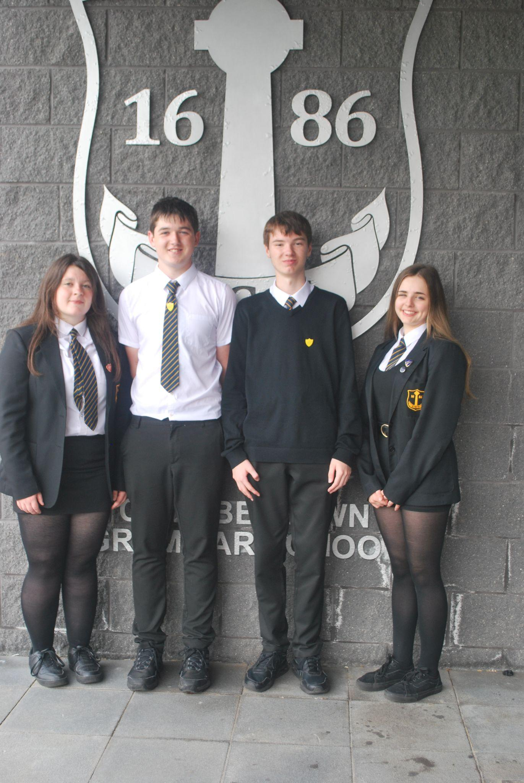
School Captains & House Captains 2024-25
We are delighted to announce our new House Captains for 2024-25.
House Captains:
Bengullion: Ivana Mati and Cara McFadzean
Kilbrannan: Emily McMurchy and Niamh Quinn
Knockscalbert: Gregor Craig and Ciara Wallace Photos to follow in next update
And as a reminder, our School Captains are:
School Captains: Aidan Brodie and Jack Ralston
Vice Captains: Evie Judge, Alice McKendrick and Mia MacLaren
L-R: Alice, Jack, Aidan and Mia.
Not available for a picture, Evie.

Slide 4
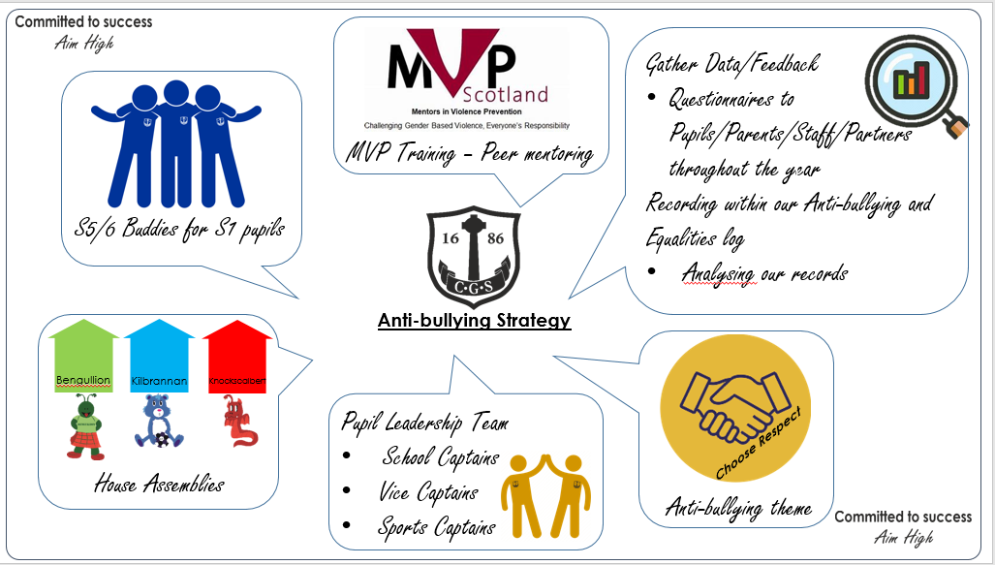
In this fortnight’s update you can see a summary of our updated anti-bullying strategy and will look forward to hearing your views over the coming months. We want to work with parents, carers, families and our young people.

Slide 5
Use of Mobile Phones in School
https://blogs.glowscotland.org.uk/ab/campbeltowngs/school-policies/mobile-technology/
Mobile phones are allowed to be used responsibly, during break times and lunch times only.
Mobile phones are not allowed to be used when travelling to and from classes.
Mobile phones must be switched off and out of sight in class unless permission has been given by a member of staff.
Mobile phones are not to be brought out in class for any purpose unless permission has been given by a member of staff.
Mobile phones should not be used in the school or its grounds to take a photograph, audio recording or video of a fellow pupil or member of staff unless permission has been given by a member of staff.

Slide 6
Use of Mobile Phones in School
https://blogs.glowscotland.org.uk/ab/campbeltowngs/school-policies/mobile-technology/
If you don’t follow the rules you will be asked to turn off your phone and put it away.
If you don’t put your phone away, you will be asked to hand your phone to the teacher and it will be returned at the end of the lesson.
If you don’t hand your phone to your teacher or continue to misuse your phone, a member of SLT will ask you for your phone and it will be returned at the end of the school day.
If you don’t hand over your phone to SLT, or you continue to misuse your phone, your parents may be asked to collect your phone. You may no longer be permitted to bring your phone to school.
WE DON’T WANT TO HAVE TO ASK YOU FOR YOUR PHONE! PLEASE FOLLOW THE RULES.

Slide 7
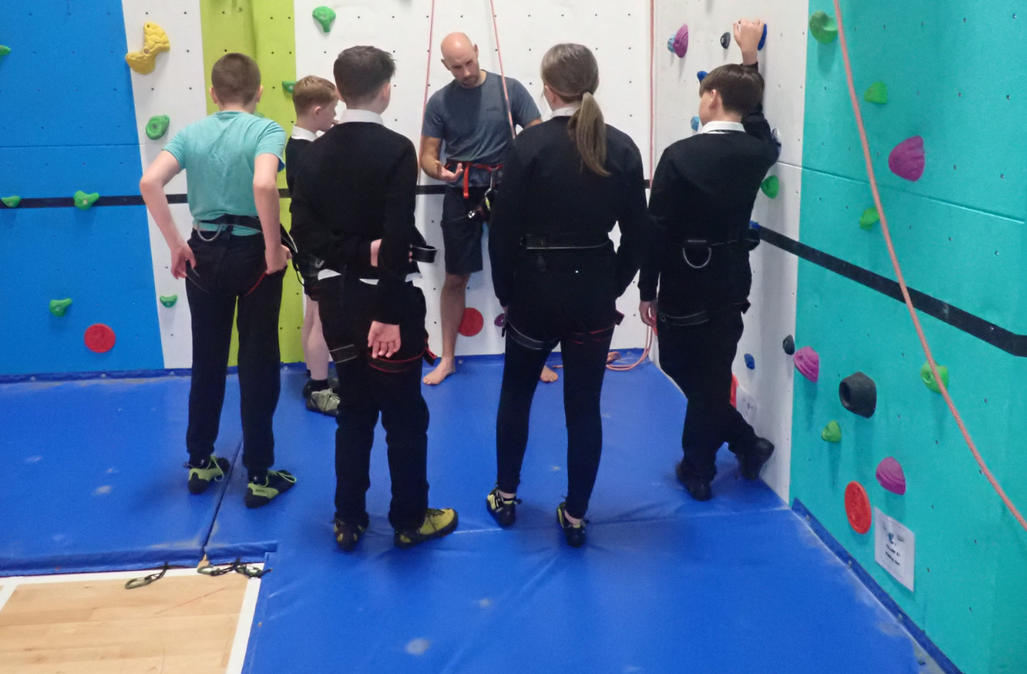
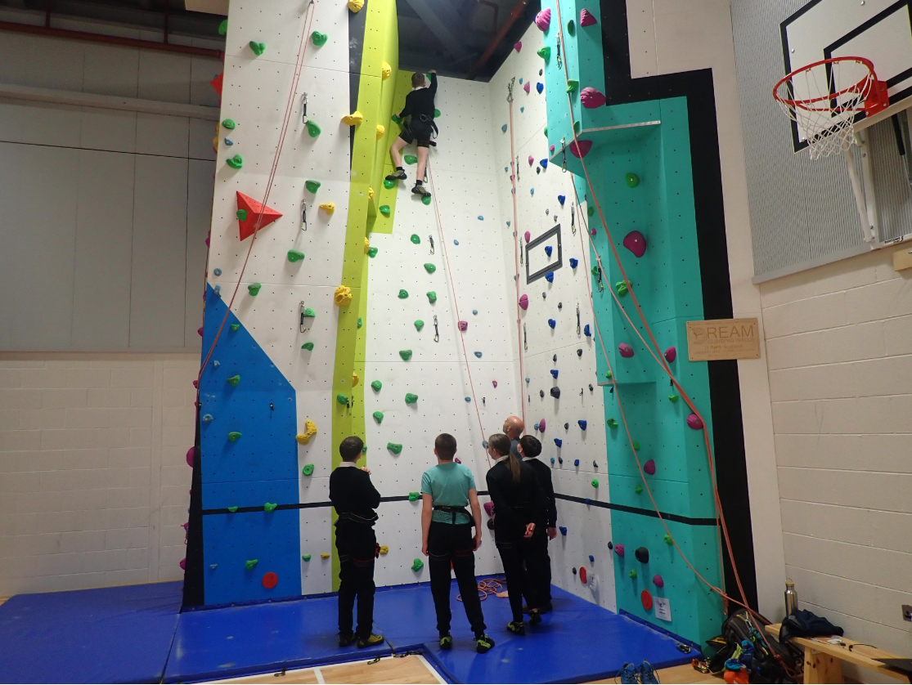
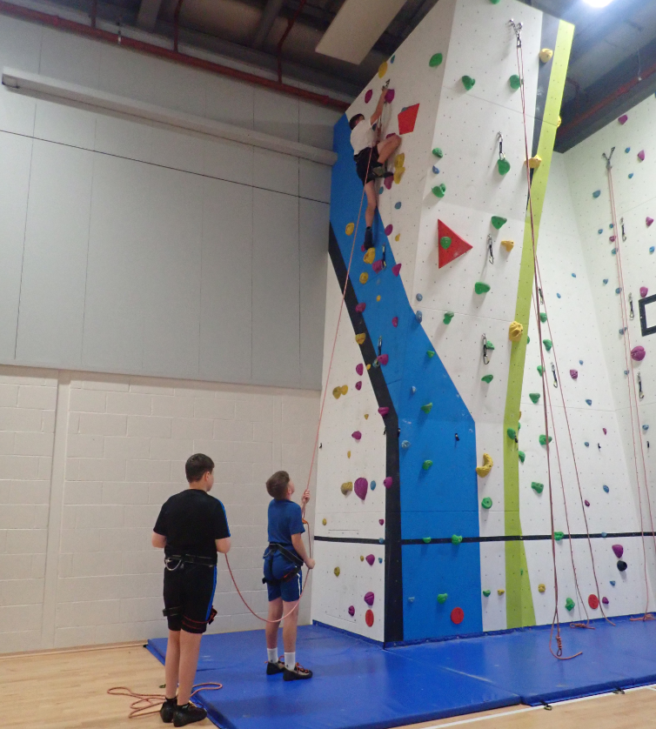
Outdoor Education - Climbing Wall
During every young person’s journey in CGS we aim to give them all an experience in Outdoor Learning and on our state of the art climbing wall lead by Mr Osborne - Outdoor Education and Geography Teacher accompanied by Mr Kenny, classroom assistant.
Our new S1 have been enjoying some sessions on the climbing wall already. They will also get an opportunity to gain an achievement award from this also.

Slide 8
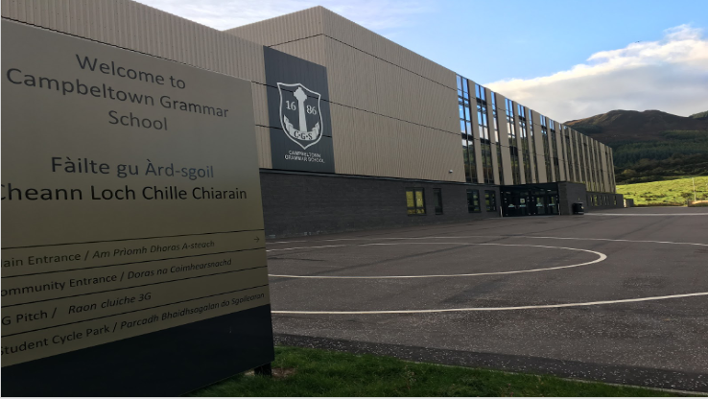
FREE Numeracy Courses for Parents
CGS are promoting a range free numeracy courses which are being delivered by UHI Argyll and funded by Argyll and Bute Council via the UK government’s Levelling Up grants.
The short numeracy courses in the attached flyer have been designed with parents and carers in mind, and will help adult get to grips with basic maths and arithmetic and enable them to help support and encourage their children’s learning.
These free courses are open to any adult, resident in Argyll and will help participants improve their numeracy skills and may enhance employability prospects.
See full course listings and how to book on our website www.argyll.uhi.ac.uk/for-business/multiply/ and you can download our poster and flyer here too Multiply Toolkit - UHI Argyll or get in touch and we can send you printed supply.

Slide 9
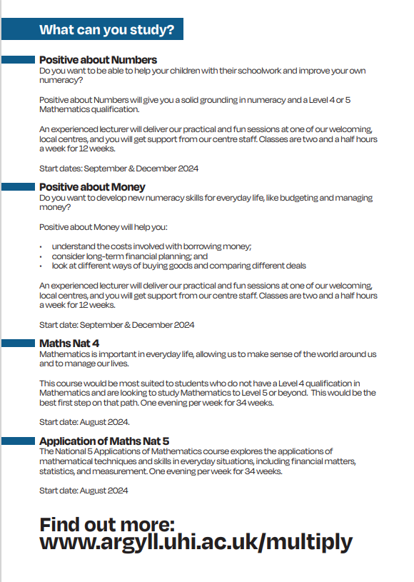

Slide 10
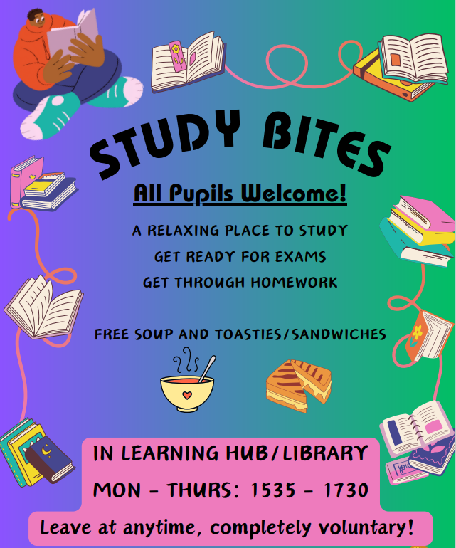
We are committed to success and raising attainment as part of our School Improvement Plan.
Study Bites is an after school learning environment where pupils can gain support to study and complete homework. All welcome.

Slide 11
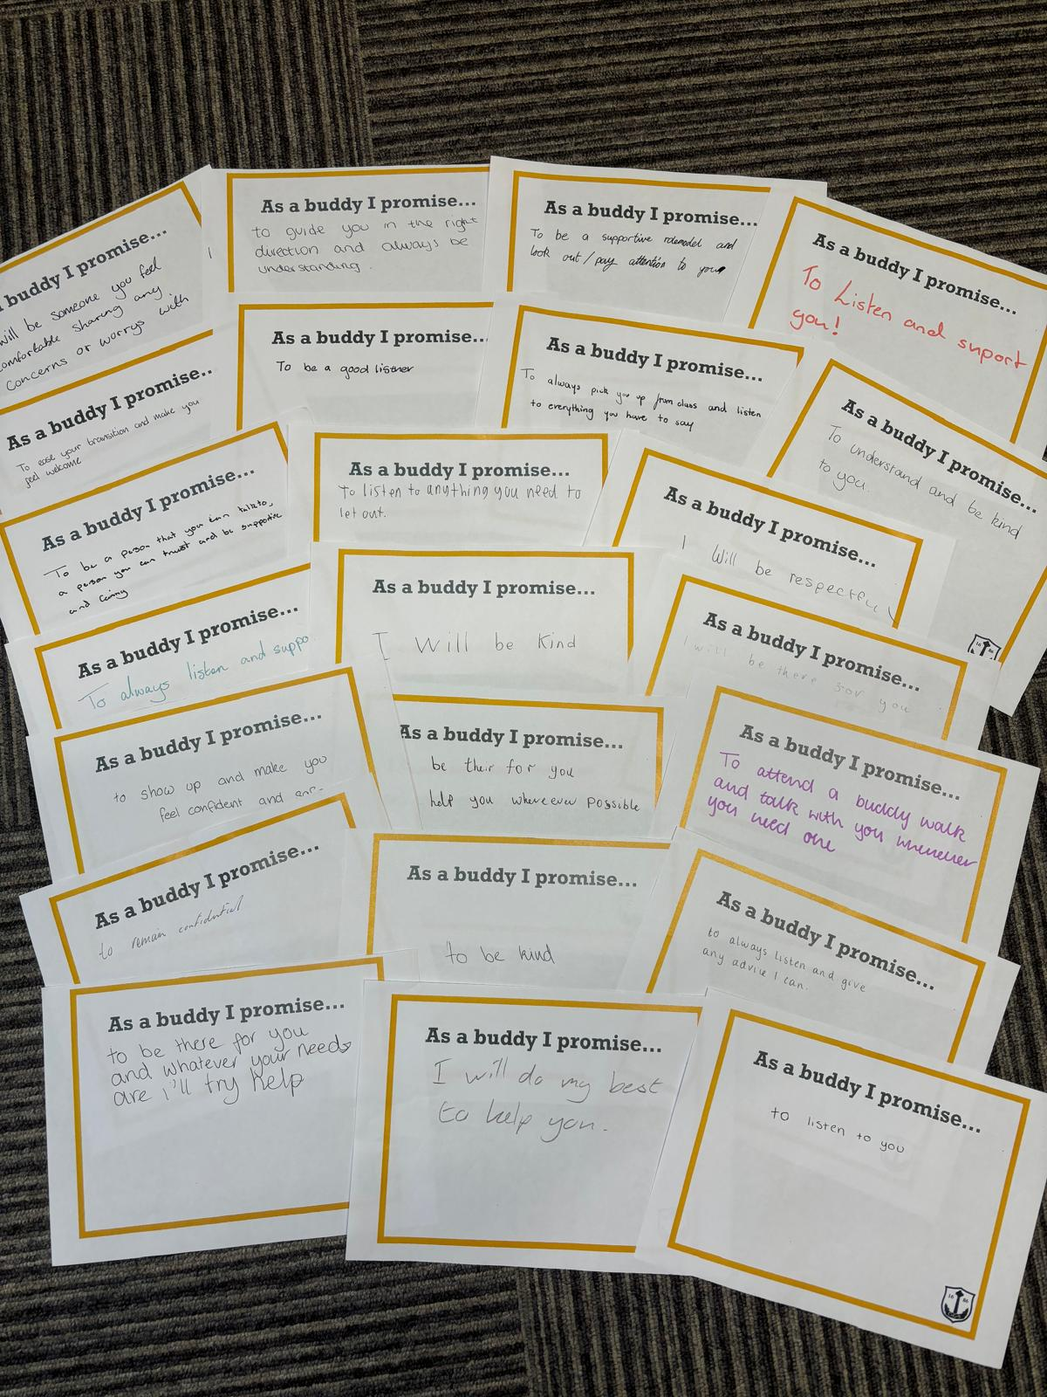
Buddy Training
A huge thank you to our S5 and S6 pupils who took part in Buddy Training today, S5 and S6 can't wait to work with our new S1 pupils!

Slide 12
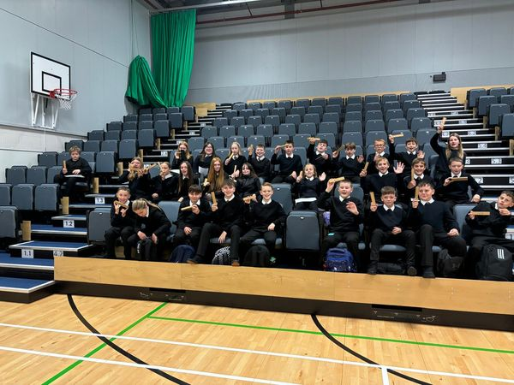
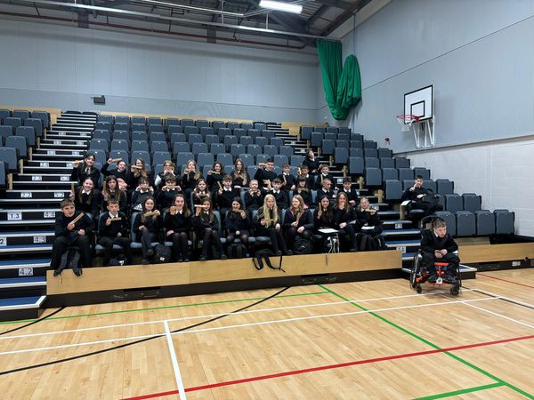
Thank you!
S1 pupils looking very pleased with their free stationery sets from Fyne Homes Ltd.
A huge thank you!
They have already been put to good use during our first week!

Slide 13
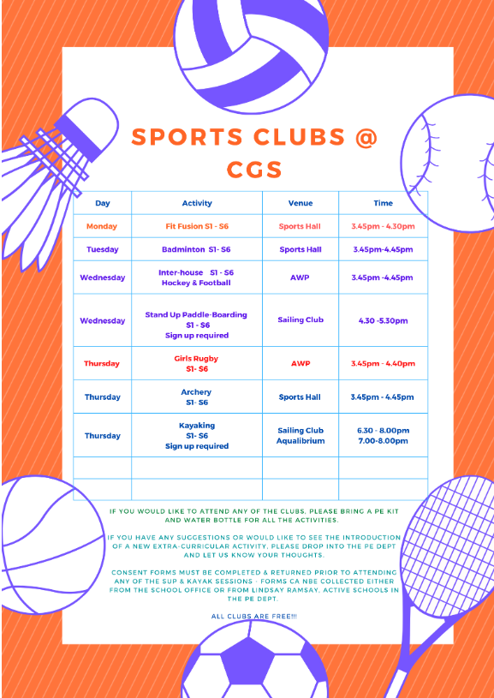
Sports Clubs @ CGS have started back this term! All Welcome!
Keep up to date with all clubs by checking our Daily Information and School Clubs Information on our school website.

Slide 15
Argyll and Bute Council School Transport Team are looking for people to join their supply list of Drivers and Pupil Escorts in the area.
If anyone is interested and would like more information they should contact:
Andrea Moir by Tel. 01369 708662 or email andrea.moir@argyll-bute.gov.uk
or
Shelagh Croucher by Tel. 01436 658987 or email shelagh.croucher@argyll-bute.gov.uk

Slide 16
Stay Informed!
Bulletin R2 Daily Information:
https://blogs.glowscotland.org.uk/ab/campbeltowngs/2019/08/30/bulletin-02-09-19/
Music Lesson Rota: https://blogs.glowscotland.org.uk/ab/campbeltowngs/2019/08/30/music-tuition-week-beginning-02-09-19/
Lunch Menu: https://blogs.glowscotland.org.uk/ab/campbeltowngs/2019/08/30/lunch-menu-02-09-19/
General School Information:
https://blogs.glowscotland.org.uk/ab/campbeltowngs/2019/08/30/school-clubs-aug-oct-2019/
School clubs:
https://blogs.glowscotland.org.uk/ab/campbeltowngs/2020/11/05/cgs-school-clubs-2020-21/
are all available on the school website!

